Slide 1
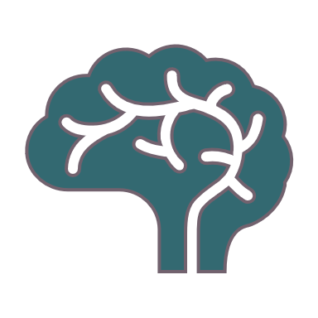
The blue brain Project
By Evi Boelen
Notes:
Good day.
Today I will be talking about the blue brain project.
I’m going to talk about what it is exactly, who founded it, why we would need it, some pro’s and con’s and many more.

Slide 2
The blue brain project?
Notes:
First i’ll start with the basics. What is “the blue brain” project exactly?

Slide 3
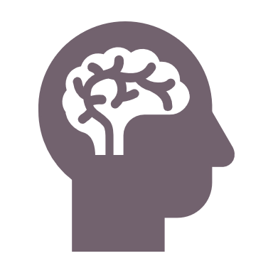
What is it?
Reverse engineer the brain of a mammal
Understand brain functions and disfunctions
Simulations on a supercomputer
Virtually recreate the brain
Notes:
The blue brain project is the first attempt to reverse engineer the brain of a mammal, in order to understand the brain functions and disfunctions through simulations on a supercomputer (computer that has a performance capacity that exceeds normal computers). So they try to virtually recreate the brain of a human to study it.

Slide 4
What is the goal?
Create a digital reconstruction of the brain
Study the nature of the brain
Understanding human decision-making, thoughts, ..
Notes:
The blue brain project’s goal is to create a complete digital reconstruction of the brain, which can be used to study the nature of the brain.
It helps in understanding how humans make decisions, experience emotions and thoughts. It gives a deeper insight to the power of the human brain.

Slide 5

Who founded it?
Henry Markram
Zwitserland
May 2005
Notes:
The project was founded by Henry Markram in Switzerland. In May of the year 2005.

Slide 6
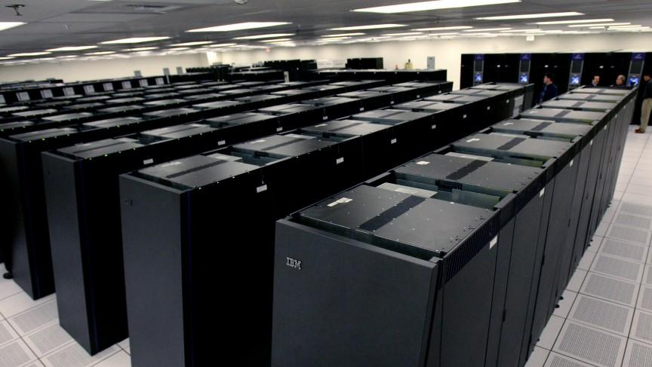
Where does the name “blue brain” come from?
Blue gene supercomputer
IBM
Especially for the simulations
Notes:
Where does the name “blue brain” come from?
The project has earned this name, because to reconstruct the brain virtually, they make use of the “blue gene supercomputer”, developed by IBM.
It was especially constructed to carry out these simulations.
In this photo you can see the famous “blue gene supercomputer”

Slide 7
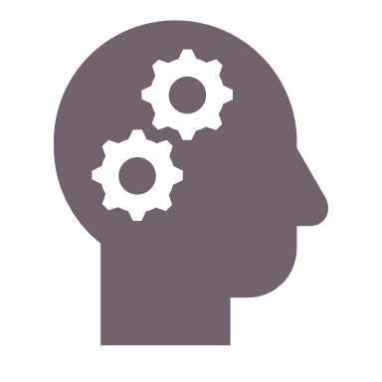
What about the future?
First virtual brain
In 3 years
100 billion neurons and 100 trillion synapses
A lot of data
2023
Notes:
Future?
It is planned that the first full human brain simulation can take place in three years.
It takes that long, because the brain is a system with 100 billion neurons and 100 trillion synapses.
To virtualize all this data can take a lot of time. So, if all goes well, we’ll have our first “virtual brain” in 2023.

Slide 8
What is a “virtual brain” and why do we need it?
Notes:
Next
We’ll talk about what a virtual brain exactly is, and why we think we need it.

Slide 9

What is a virtual brain?
Artificial brain
Think like a natural brain
Make decisions based on past experiences
Only possible with a supercomputer
Interface between the human brain and the artificial brain
Notes:
What is a virtual brain and why do we need it?
A virtual brain is an artificial brain.
It can think like a natural brain, and take decisions based on past experiences.
It is possible to do this with a supercomputer that has a very big storage capacity amongst other specifications.
There is an interface between the human and the artificial brain.
In this way the human brain can be uploaded to the computer.

Slide 10
Why do we need it?
We always need intelligent minds
These minds will not be lost
Difficulty remembering things
Takes away the extra stress
Solution to very common human problems
Notes:
Human society would always need intelligent minds, and this way an intelligent mind can stay alive, even after death
We often face difficulties in remembering things. Such as birthdays or spelling of words, etc. a virtual brain can take away the extra stress we all face to remember these things.
It is a perfect solution to a very common human problem.

Slide 11
How does a virtual brain work?
Normal brain input
Virtual brain input
Neurons transmit information
Sensory cells produce electric impulses
Neurons transfer these to the brain
Interpretation: by means of certain states of many neurons the brain knows
Silicon chip replaces the neurons
Sensory cells produce electric impulses
The chip recieves these and sends information to the supercomputer
Interpretation: by registers with different values
Notes:
How does a virtual brain work?
Normal brain
Neurons transmit information to sensory cells. Sensory cells produce electric impulses and send those to neurons. These transfer the pulses to the brain
Electric impulses are received by the brain. These impulses are interpreted by the brain by the means of certain states of many neurons
Virtual brain
Neurons can be replaced by a silicon chip. The impulses from the sensory cells are received through the chip, and sent to a supercomputer for interpretation.
Interpretation
The electric impulses are received by the chip and interpreted by means of a set of different registers (with different values that represent states of the brain)

Slide 12
Is it possible to copy data from the brain to the computer?
Short: Yes
Long: It is possible
Nanobots
Travel through our system
Provide scan of connections
Notes:
Is it possible to copy data from the brain to the computer?
Short: yes
Longer: the uploading is possible by the use of nanobots.
These bots are small enough to travel through our circulatory system, our spine and last our brain.
They will be able to provide a complete scan of the connections in the brain.
This information will be entered into a computer, which could continue to function as us.

Slide 13
Pro’s and con’s
Notes:
Now,
We’ll look at some pro’s and con’s of the possibility of an artificial brain

Slide 14
Pro’s
Intelligence after death
Could be used to study animal behaviour
Allow deaf to hear
Can provide a solution to mental disorders
Notes:
Pros:
After death our intelligence can be used to teach others the knowledge we had
This could also be used to study animal behavior. In order to understand animals and their thoughts better.
This can be used to allow the deaf to hear via direct nerve stimulation, or can provide a solution to mental disorder

Slide 15
Con’s
We depend on technology
Computer virusses
Human cloning
Notes:
Cons:
Humans depend even more on technology than we do now
Computer viruses will pose an increasingly critical threat when your mind is digitalized. Hacking is also a concern, If a virtual brain is hacked, the hacker will posses all the knowledge that was uploaded into the virtual brain.
This may lead to human cloning, and we cannot imagine how big this threat would be against nature

Slide 16
Conclusion
Notes:
Conclusion
This project (if implemented successfully) would change many things and boost the area of research and technology.
Thankyou for your undivided attention
Are there any questions?

